Slide 1

TECHCARE
TEAM ::: TECH SOLUTIONS

Slide 2


AGENDA
To give a brief structure of the project

Slide 3

PROBLEM STATEMENT
Lack of Accessibility
Inconvenience
Quality of Service

Slide 4

PROJECT OVERVIEW
The Home Service That Saves You Time and Money. We Take Care of Everything. Our Expert Technicians Will Fix Your Device in Your Home.

Slide 5

WHO ARE THE END USERS?
student's
Pprofessional's
Companies

Slide 6

YOUR SOLUTION AND ITS VALUE PROPOSITION
We provide top-notch repair services for laptops and electronics.
Effortlessly book our services online. We're just a click away

Slide 7
THE WOW IN YOUR SOLUTION
Trust us for top-notch laptop repair services.
We provide comprehensive desktop repair services.
Get software installed hassle-free by our team.
We offer expert upgrades and maintenance solutions.

Slide 8
HOME
SIGN IN
TECH SOLUTIONS
FLOW CHART OF CODINGNEST
ABOUT US
REGISTER
CONTACT
LOGIN

Slide 9
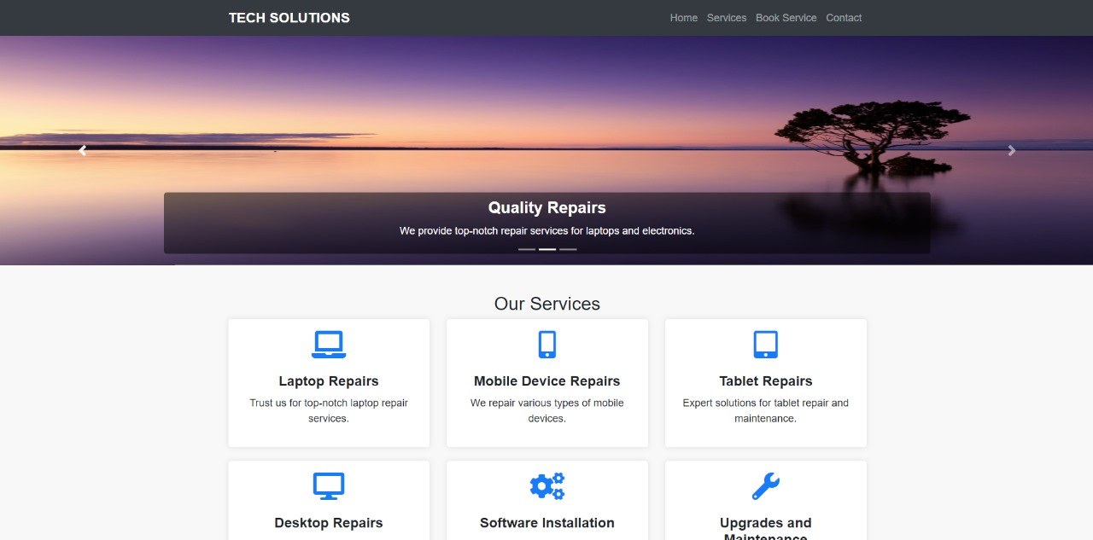
RESULTS

Slide 10
MEET OUR TEAM
Dinesh Kumar
Hatwar Aman
Rakesh Kumar
Md Gaffar

Slide 11
Thank You All ...

